Slide 1
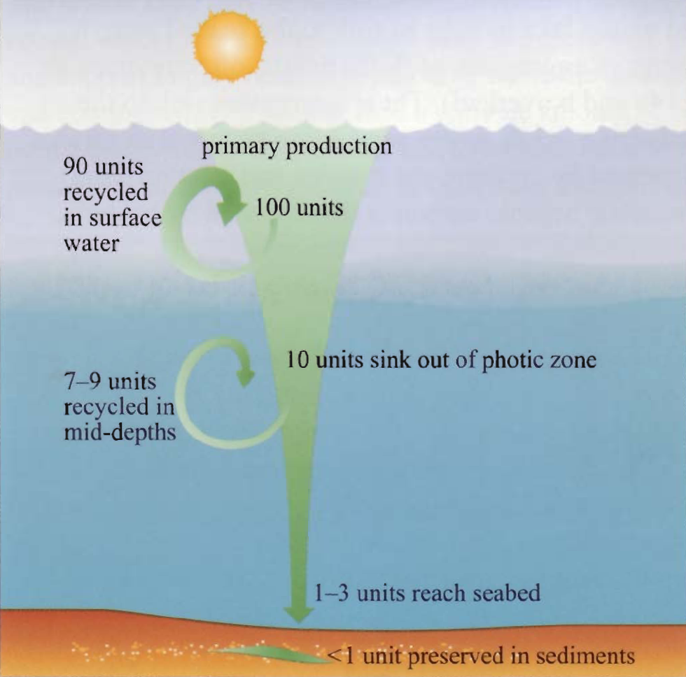
Marine NPP
20-44 Pg C/yr -> 30-60 % global NPP (land + sea)
Greatest per unit area in photic zone, coastal, & upwelling areas
80% of total in open ocean due to large area
(NPP)
Photic Zone
Degraded to
CO₂, NO₃, PO₄
“Biological Pump”
Deep water
Continued decay and
nutrient release
~80% on continental shelf
NEP > 0 resulting in O₂
release to atmosphere

Slide 3
Global Nutrient Cycles
(AKA Global Biogeochemical Cycles)
The Global C Cycle

Slide 4
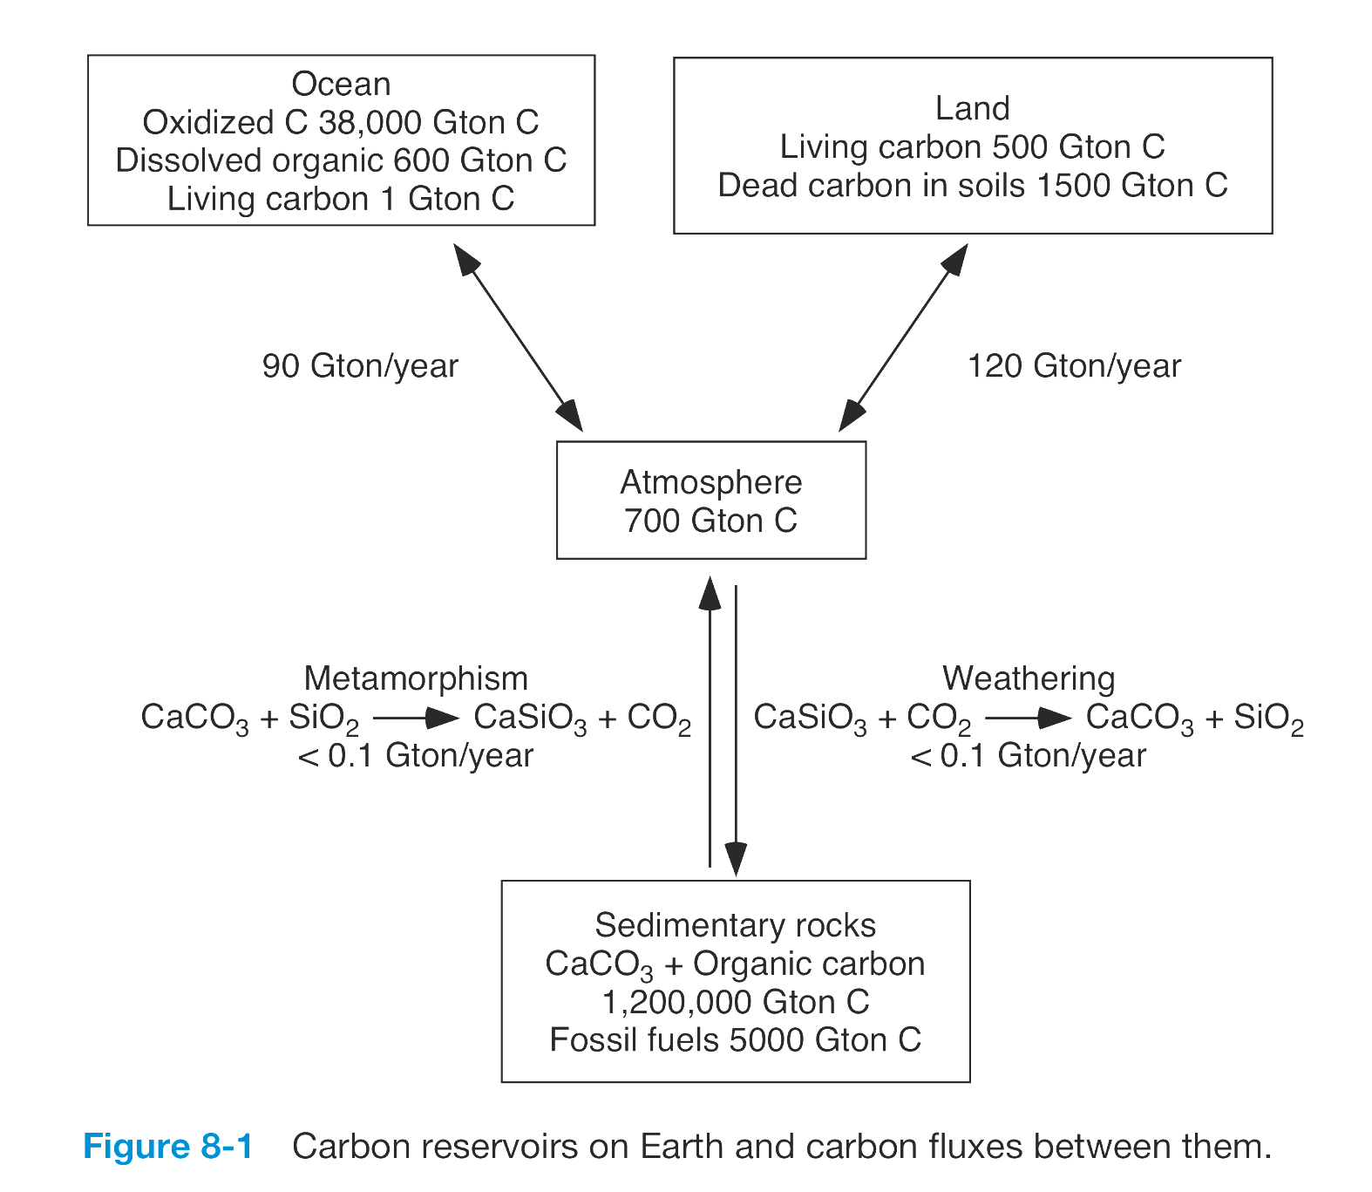
The breathing Earth
The importance of the processes involved depends on the time scale.
“BREATHING” ocean
Large amount, moderate turnover
(Centuries)
PANTING” terrestrial biosphere
Modest amount, rapid turnover
(Decades)
The “AIRPORT” terminal
Tiny amount, very fast turnover
(Years)
70,000,000 Gton C
Fossil fuels 4,000 Gton C
“SNORING” rocks
Enormous amount, slow turnover
(Hundreds of millions of years)

Slide 5
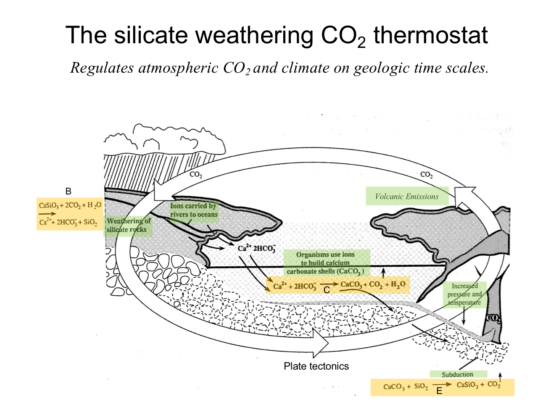
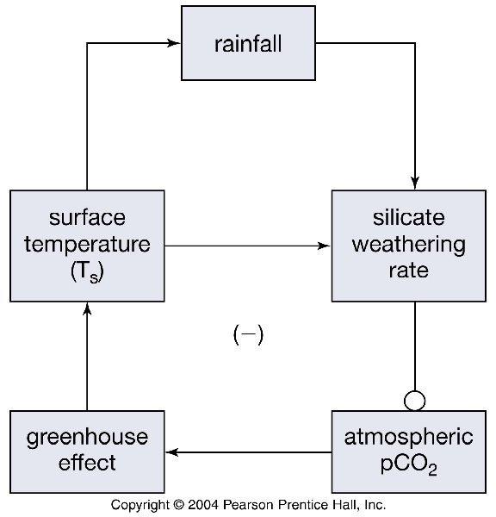
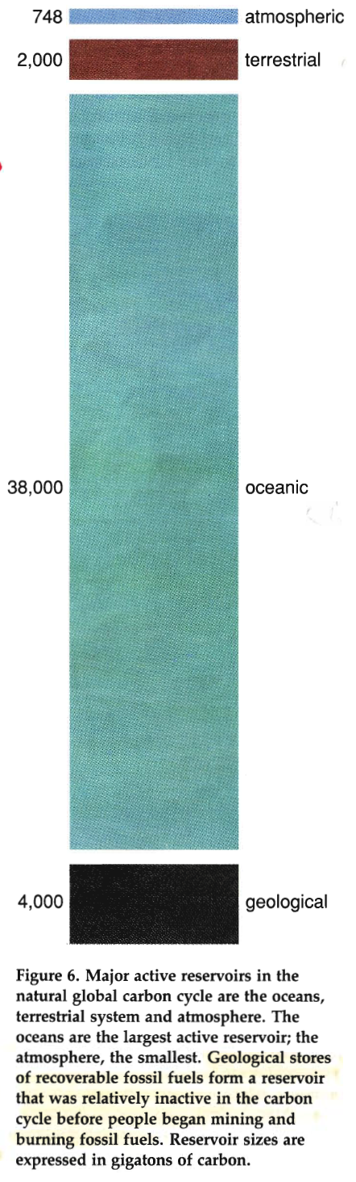
Schlesinger 1991
Carbonate-Silicate
Long-Term Feedback Loop
Distribution of Actively Cycled Carbon
(~3% of total carbon in the crust)
1.6 %
4.5 %
75 % Soils
25 % Plants
84.8 %
97 % DIC ==> ~1 CO₂ : 100 HCO₃⁻ : 10 CO₃⁼
3 % DOC
9.0 %
Kump et al. 2010 Fig.8-18

Slide 6
Organic Carbon
Long-Term Feedback Loops
Weathering
P
Climate
T & Precip.
CO2
( - )
Plant Available
P
Plant Growth
Org. C Burial in Sediment
Plant Growth
( - )
( - )
Iron-P
Burial
O₂
Marine N Fixation
Positive coupling
Negative coupling
Berner 2004 (Fig. 3.1)

Slide 7
Notes:
So small imbalances in these biologically controlled processes can make a big difference – either mitigating or enhancing rising CO2 levels. That is an small imbalance can have, and is having, important feedback to the global climate.
Because CO2 does not limit photosynthesis significantly
in the ocean, the biological pump does not take up and store
anthropogenic carbon directly. Rather, marine biological cycling
of carbon may undergo changes due to high CO2 concentrations,
via feedbacks in response to a changing climate. The speed with
which anthropogenic CO2 is taken up effectively by the ocean,
however, depends on how quickly surface waters are transported
and mixed into the intermediate and deep layers of the ocean. A
considerable amount of anthropogenic CO2 can be buffered or
neutralized by dissolution of CaCO3 from surface sediments in
the deep sea, but this process requires many thousands of years.
Atmosphere contains ~ 780 Pg C
Soils ~ 1500 Pg C
Plants ~ 560 Pg C
Sources are Schlesinger, IPCC WGI 2007, Houghton 2005, and Canadell et al. 2007

Slide 9
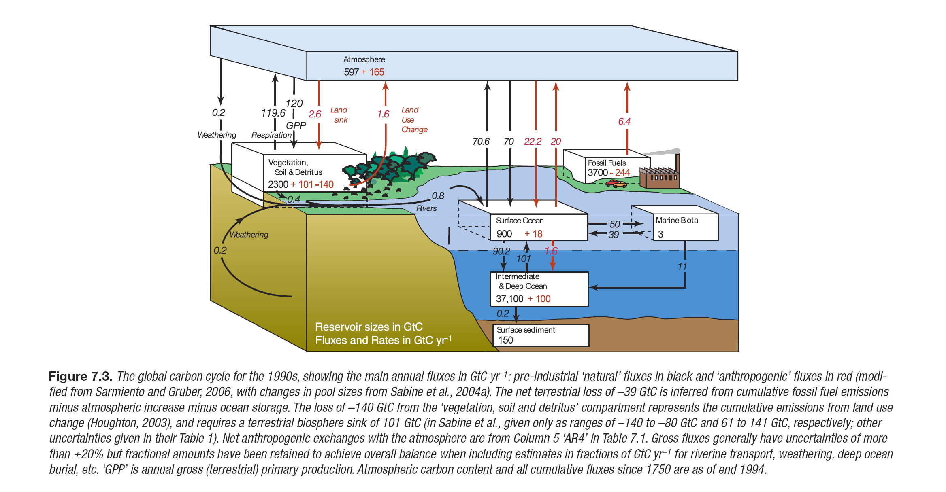
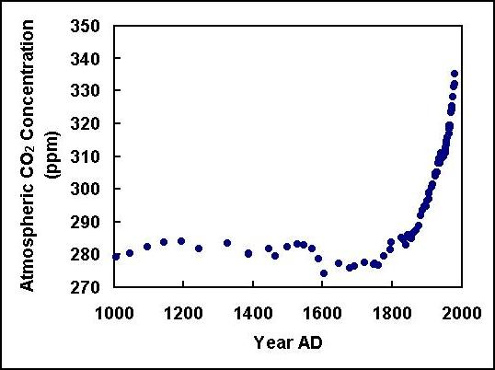
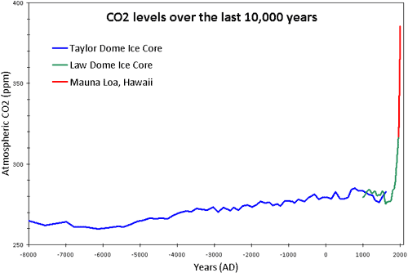
IPCC 2007 Chpt. 7

Slide 10
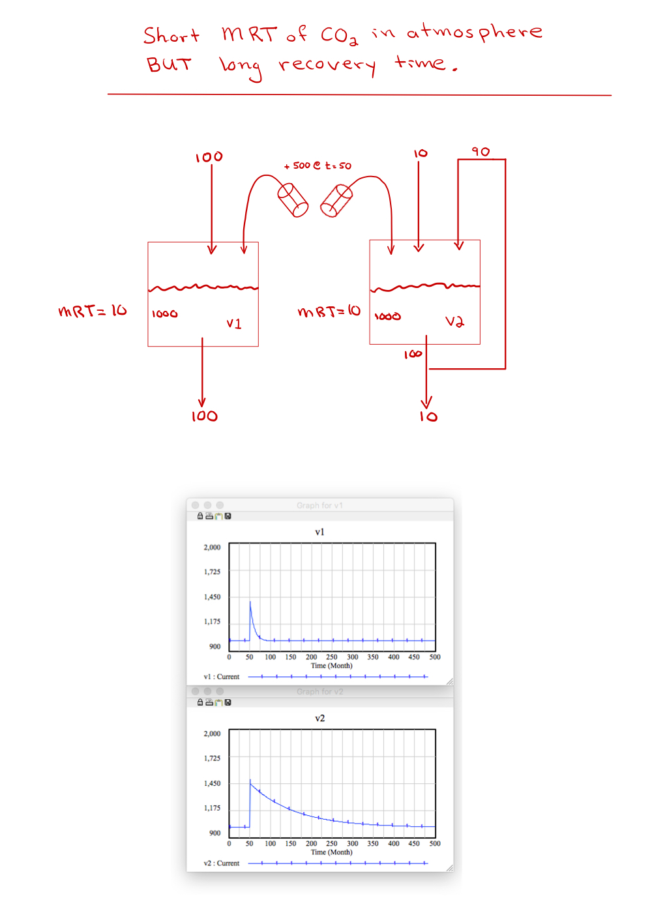

Slide 11
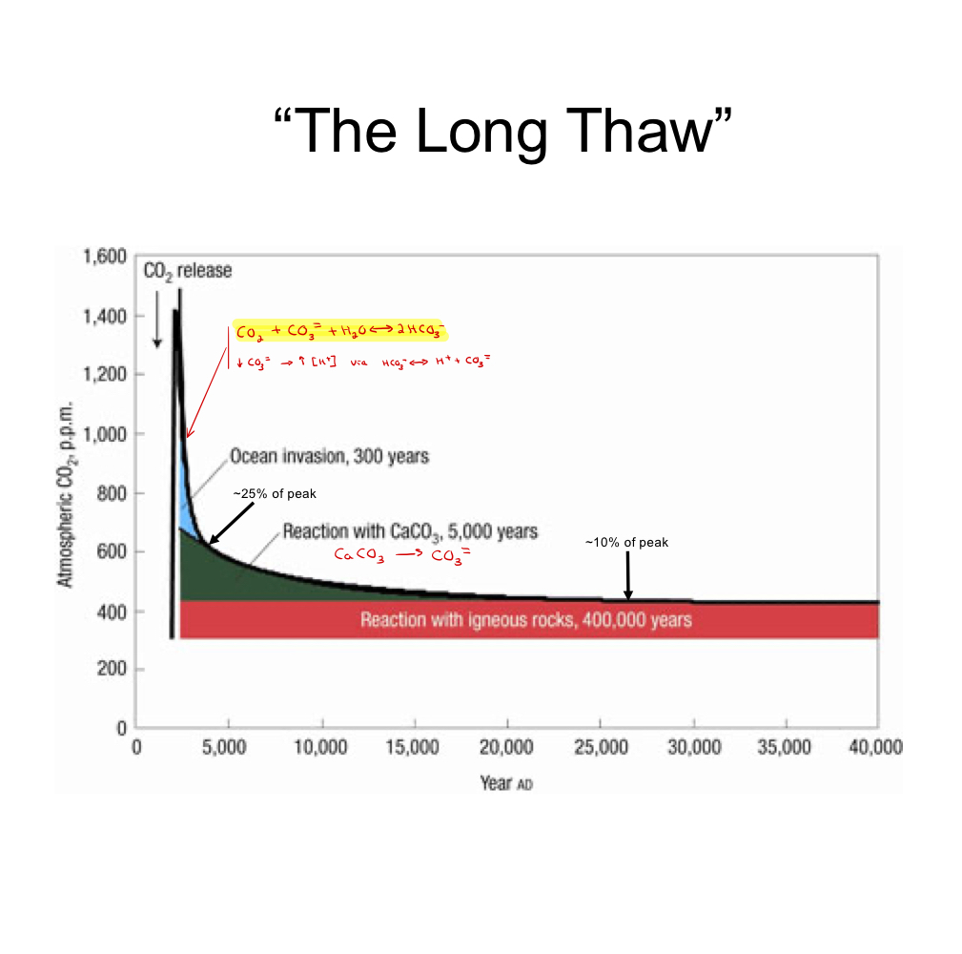

Slide 12
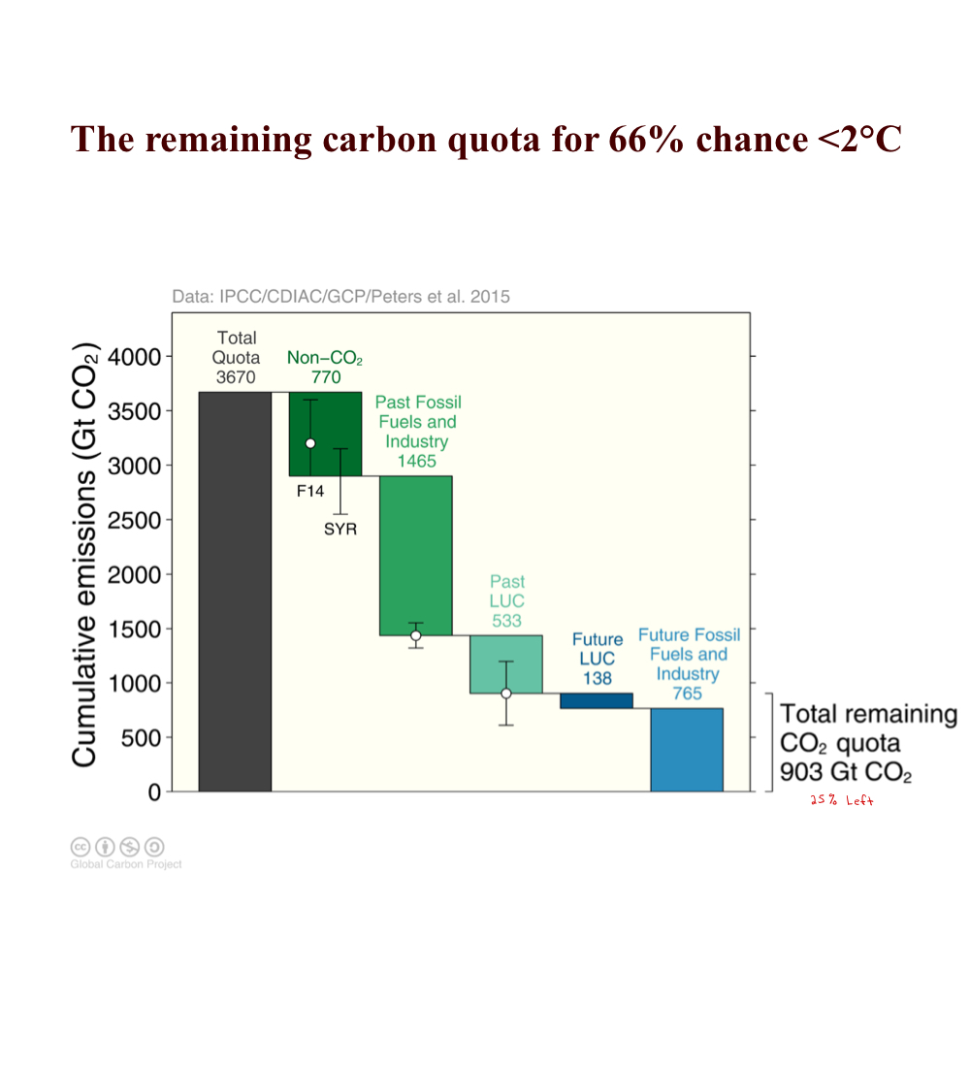

Slide 13
Mother nature mitigates
climate change to some extent.
Notes:
Residue is included in the land sink

Slide 14
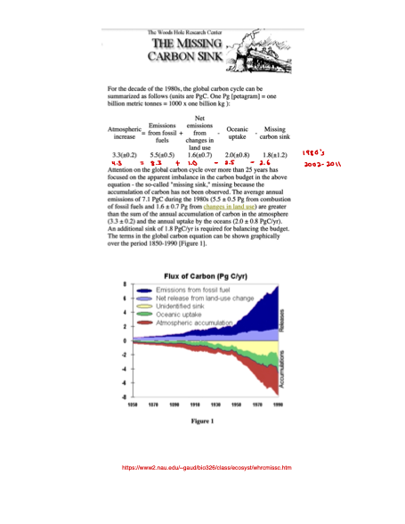

Slide 15
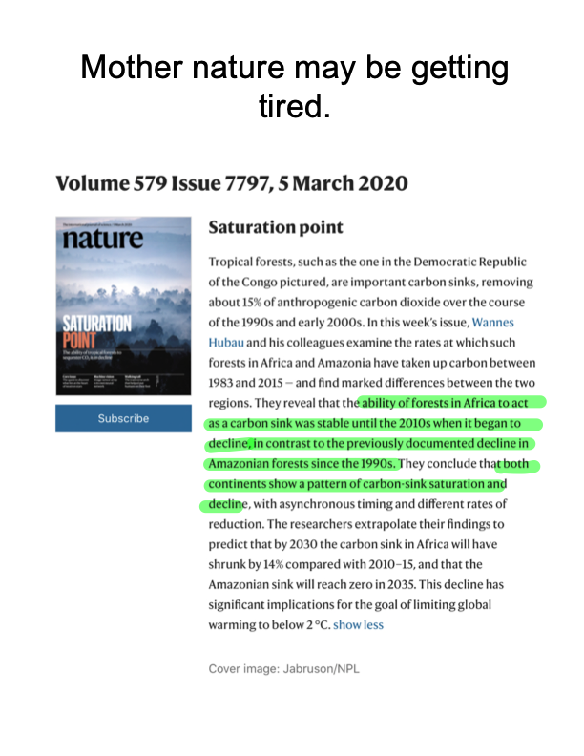

Slide 16
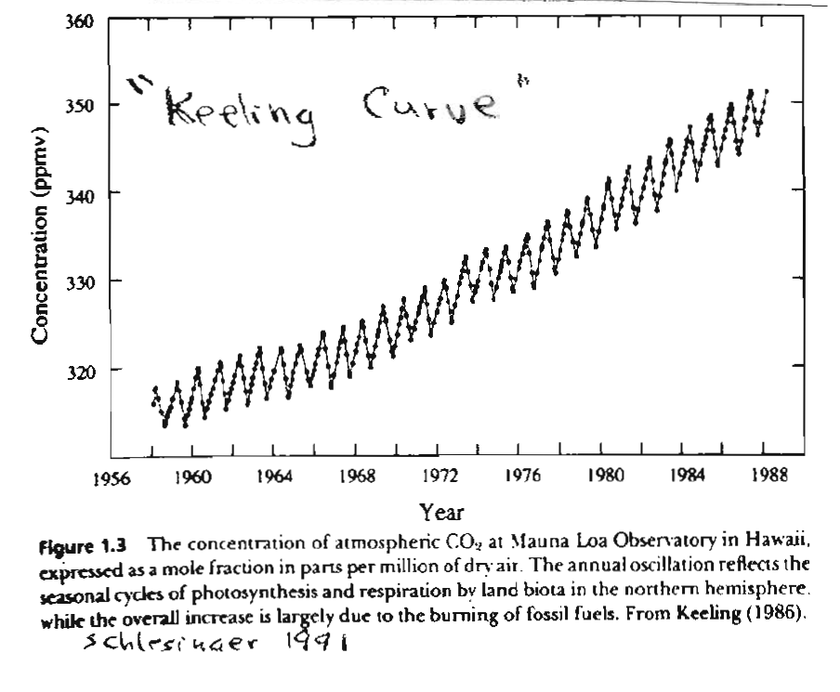
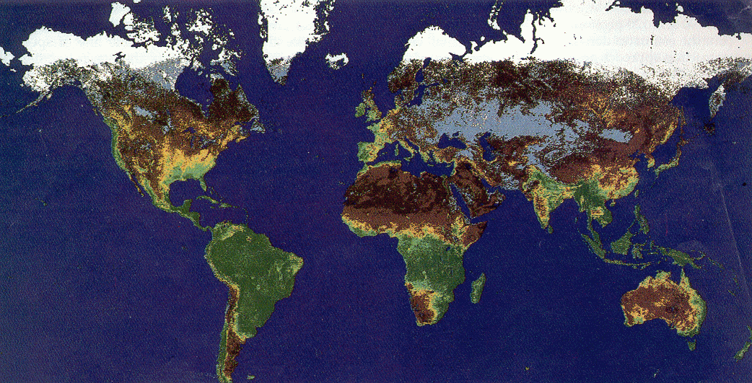
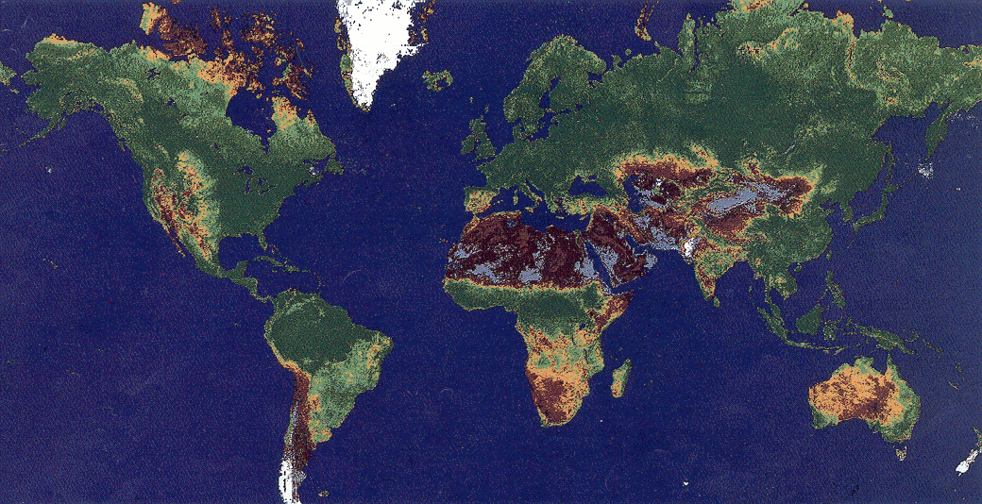
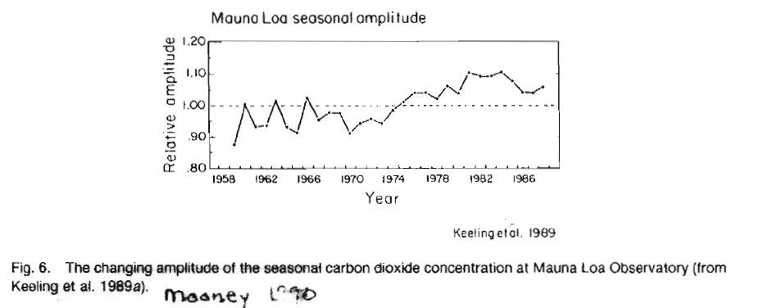
The Breathing Earth
Jan. - Feb.
July - Aug.

Slide 17
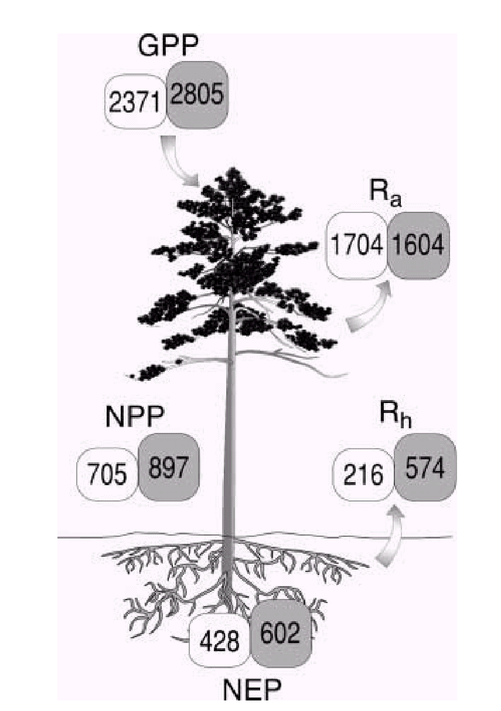
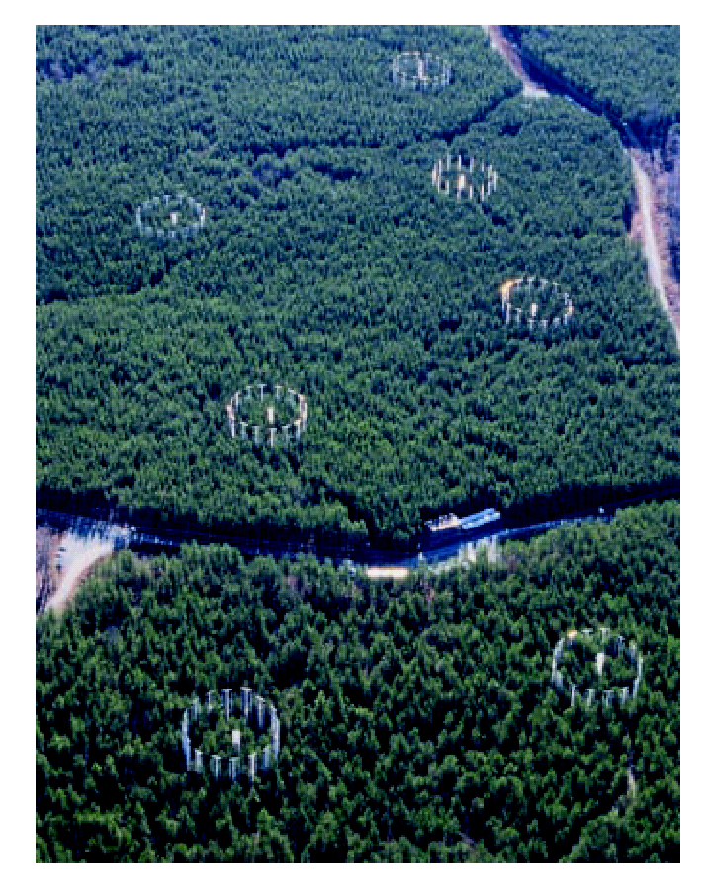
Duke FACE Experiment
27 % increase in
NPP after 4 years
Hamilton et al. 2002

Slide 18
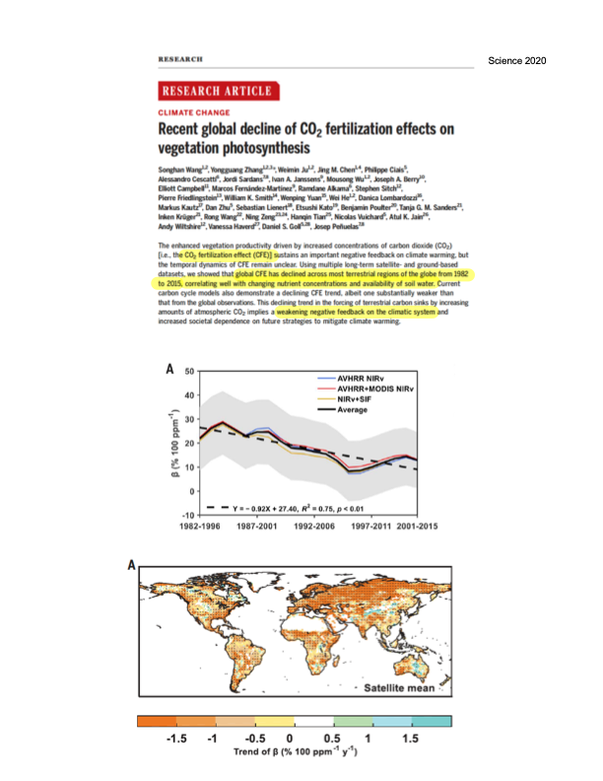

Slide 19
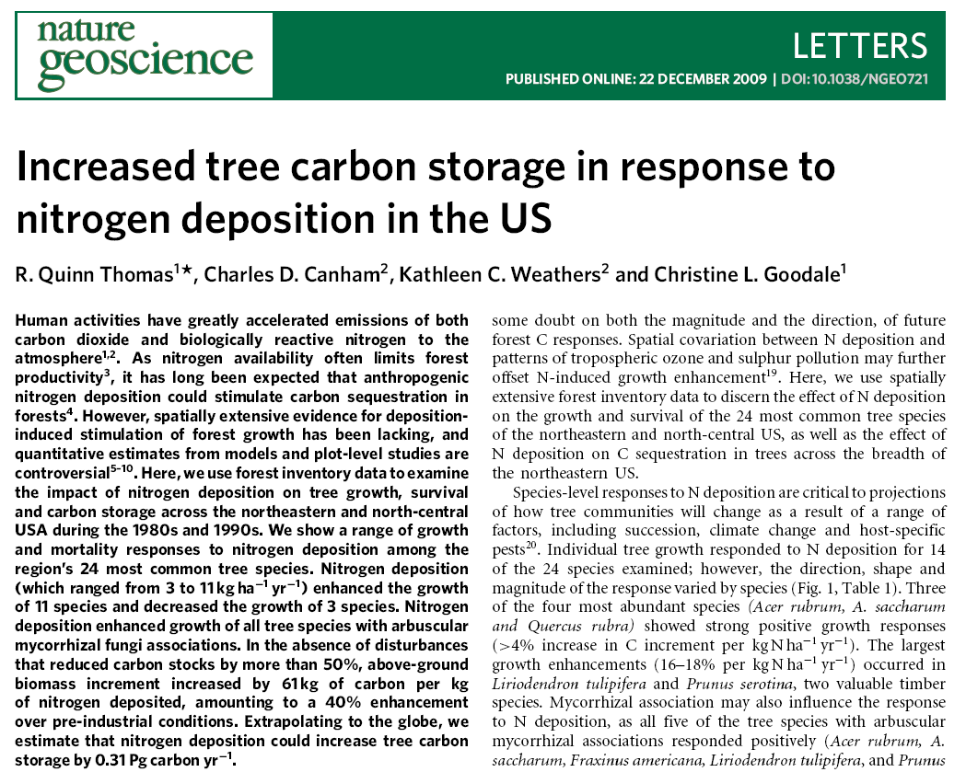

Slide 20
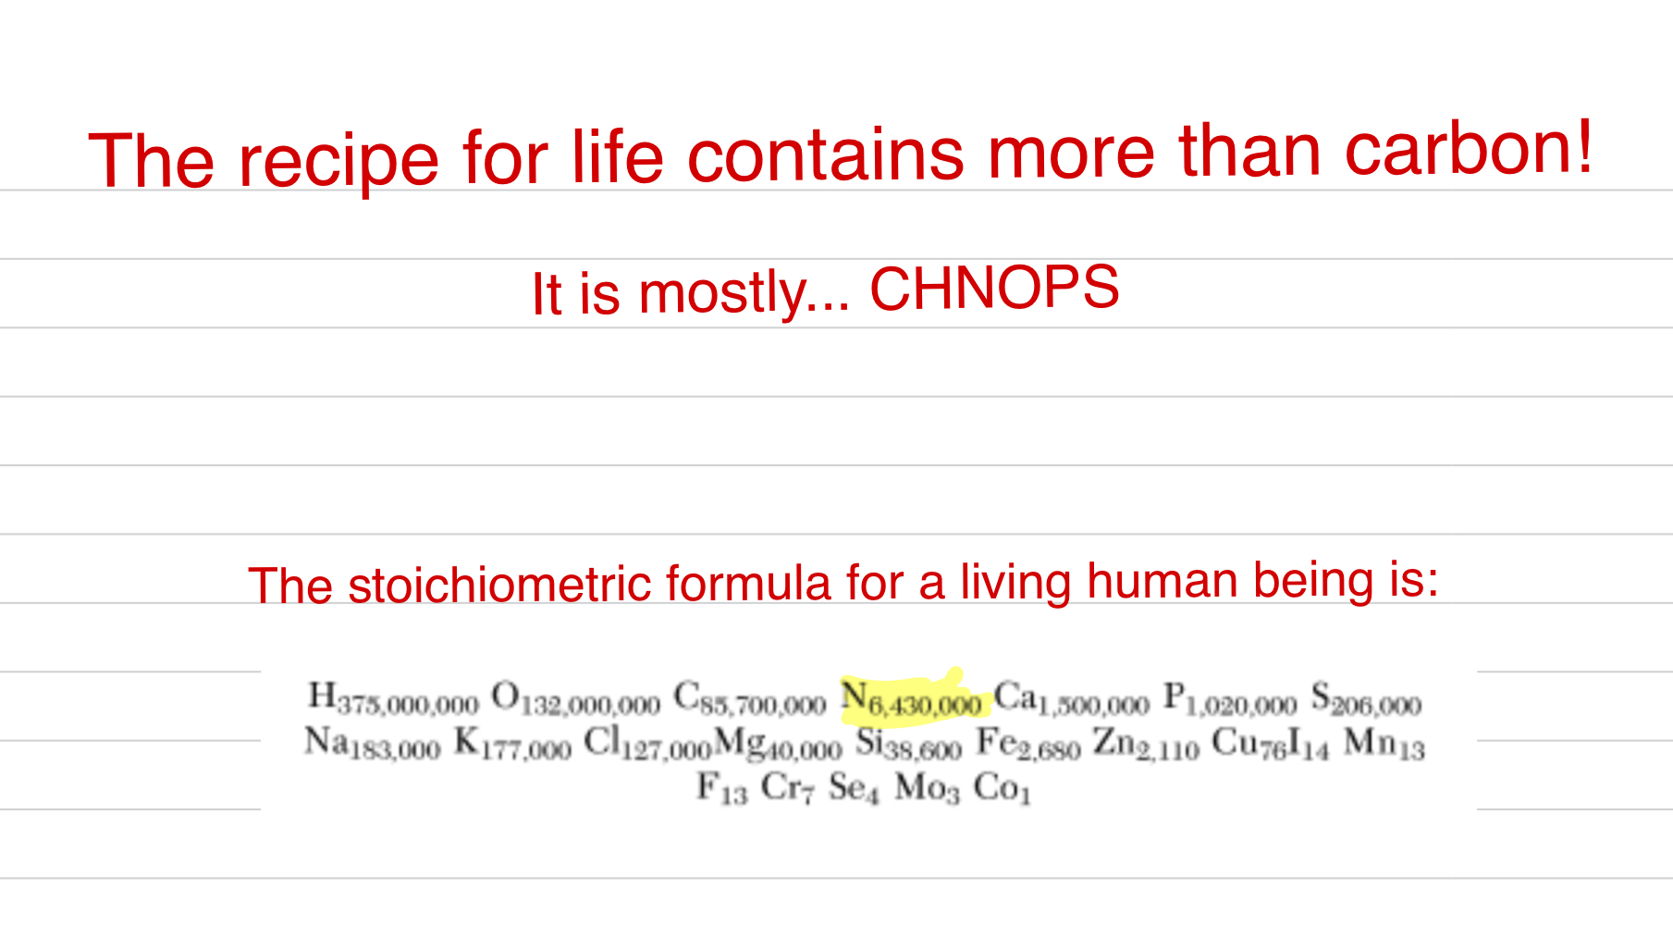
The Global N Cycle

Slide 23
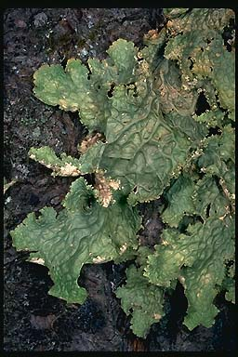
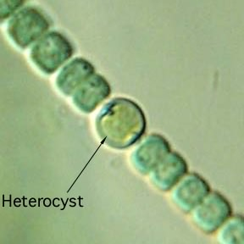
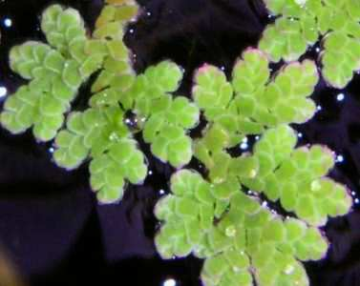
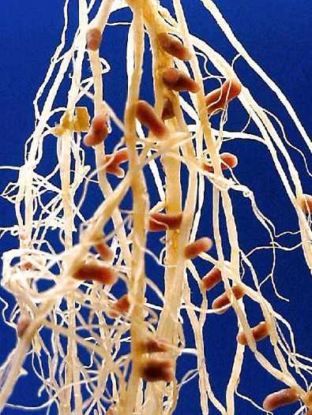
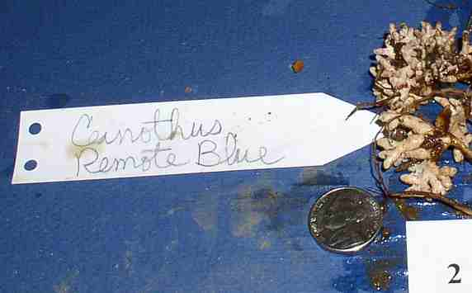
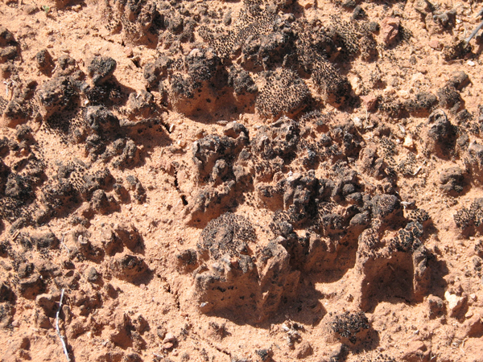
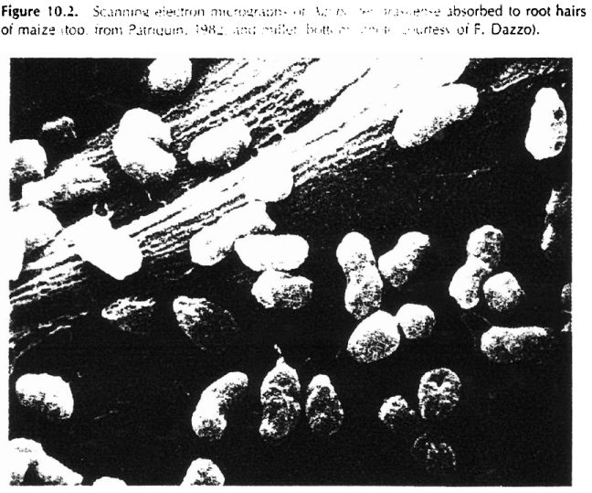
Free living & symbiotic (mutualistic)
Notes:
The aquatic fern Azolla is the only fern that can fix nitrogen. It does so by virtue of a symbiotic association with a cyanobacterium (Anabaena azollae). Azolla is found worldwide and is sometimes used as a valuable source of nitrogen for agriculture
Young plants of red alder (Alnus rubra). Alder is a N-fixing plant that forms a symbiotic association with bacteria (more specifically an actinomycete) of the genus Frankia.
Lobaria pulmonaria, a common N-fixing lichen in Pacific Northwest forests. The nitrogen-fixing symbiont is the cyanobacterium Nostoc which is to be found in pockets within the lichen referred to as cephalodia. Lichens such as this are a major source of N in old growth forests.

Slide 24
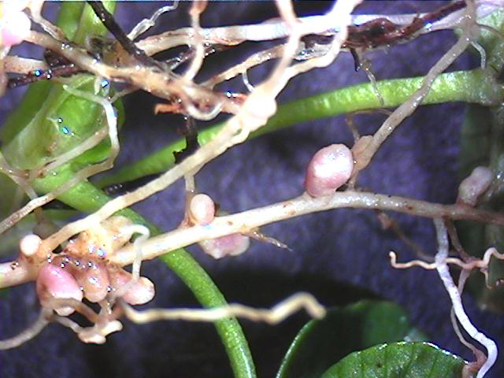
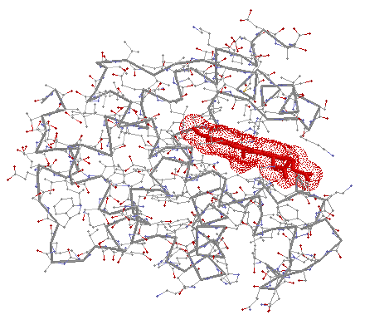
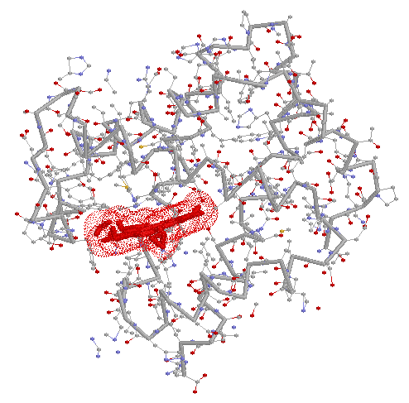
Leghemoglobin
Human hemoglobin, chain A

Slide 25
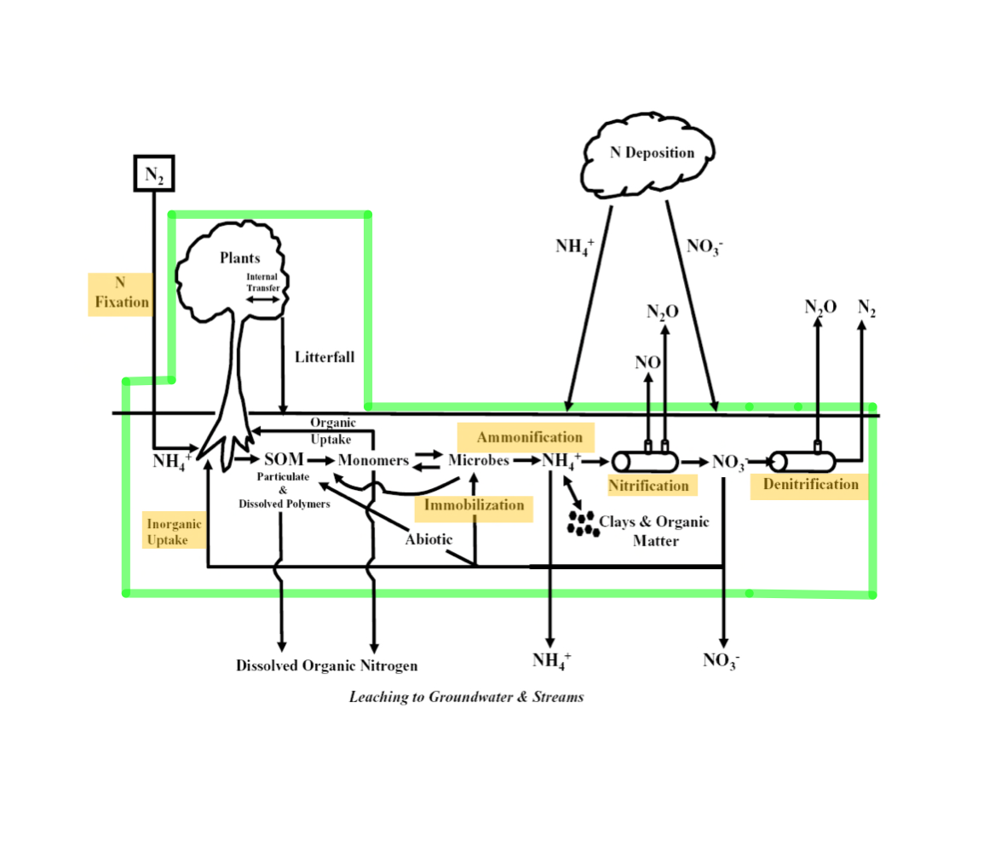

Slide 26
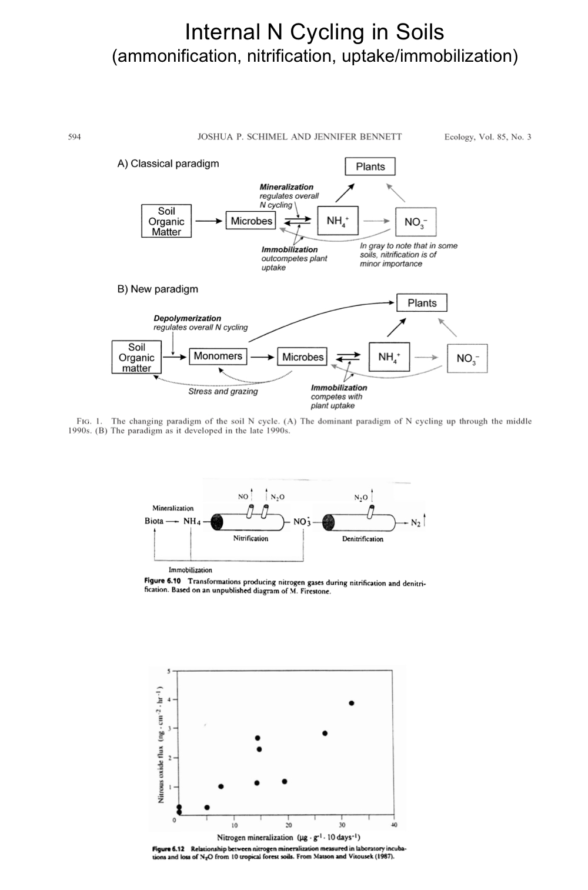

Slide 29
Global N Cycle

Slide 30
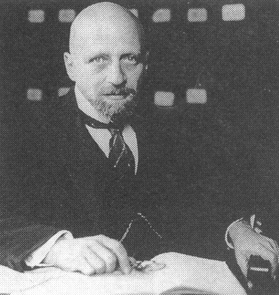
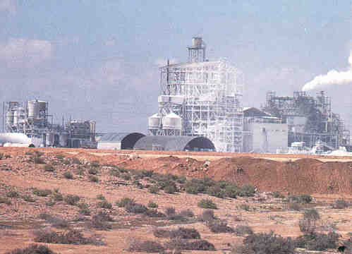
Humans Fix Nitrogen Too !
The Haber Process
3CH₄ + 6 H₂O =>3CO₂ + 12 H₂
4N₂ + 12 H₂ + catalyst ==> 8 NH₃
at 500ºC & several hundred atmospheres of pressure
Fritz Haber
https://radiolab.org/episodes/180132-how-do-you-solve-problem-fritz-haber
Notes:
Gress et al. 2007:
Nutrient limitation is of great economic and ecological
importance because it can constrain the productivity
of agricultural and natural ecosystems. Billions of
dollars are spent every year on the production and use
of fertilizers in the United States alone (National
Agricultural Statistics Service 2005), and since global
food production is highly dependent on nutrient
additions, as the human population grows this expenditure
is likely to remain significant (Smil 2001).
Nutrient limitations not only constrain ecosystem
productivity, but also influence its composition, diversity,
interspecific interactions, and cycling of other
essential materials (Vitousek 2004).

Slide 31
Atmospheric N deposition has increased in time & space
1860
1990
2050
Galloway et al. 2004

Slide 32
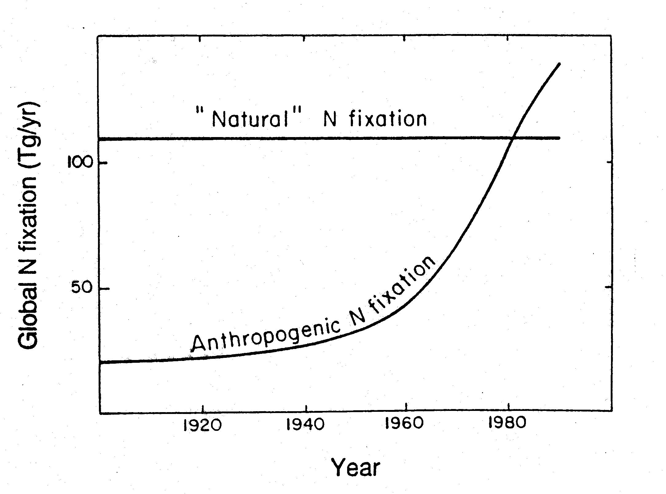
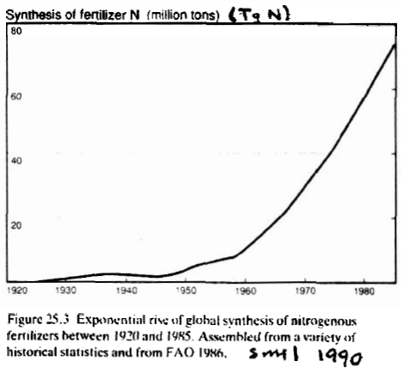
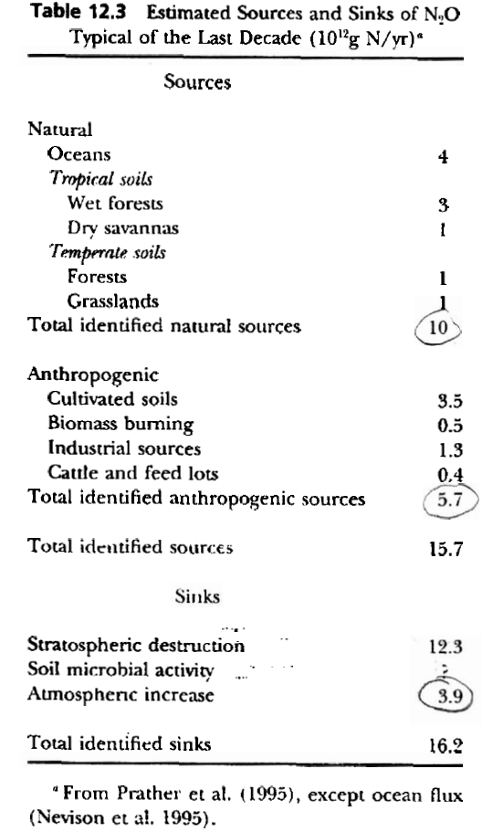
Vitousek 1994

Slide 33
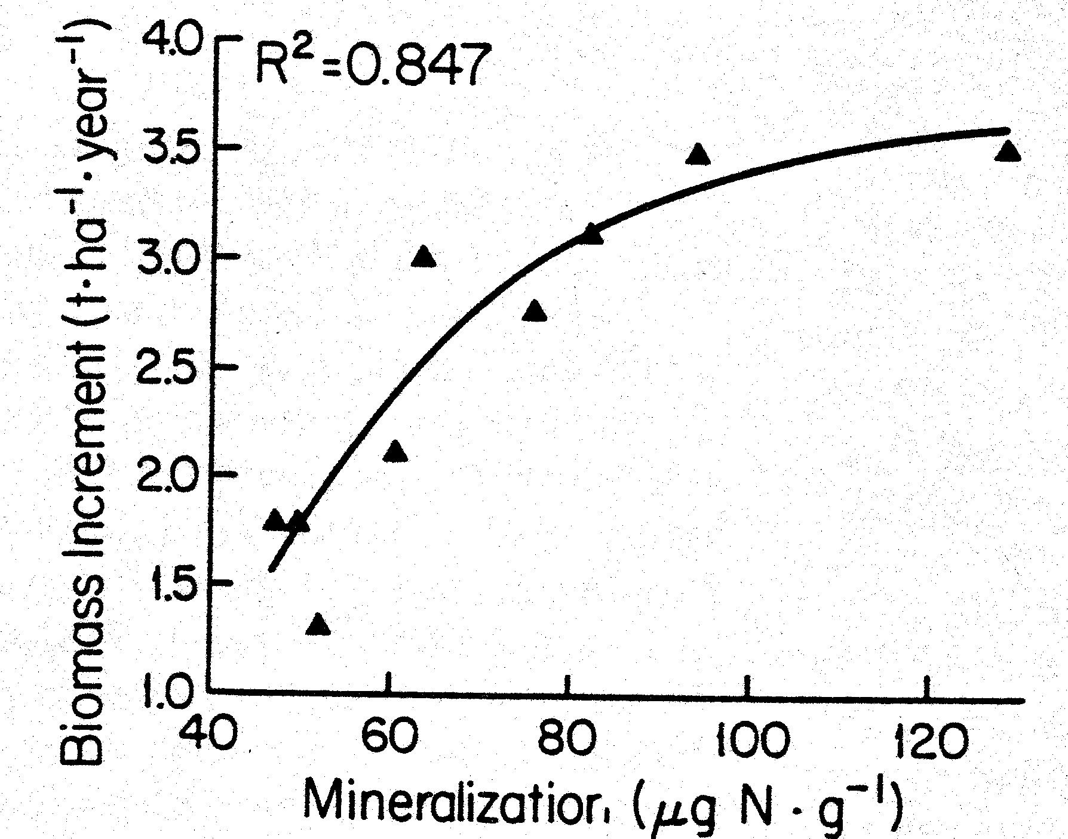
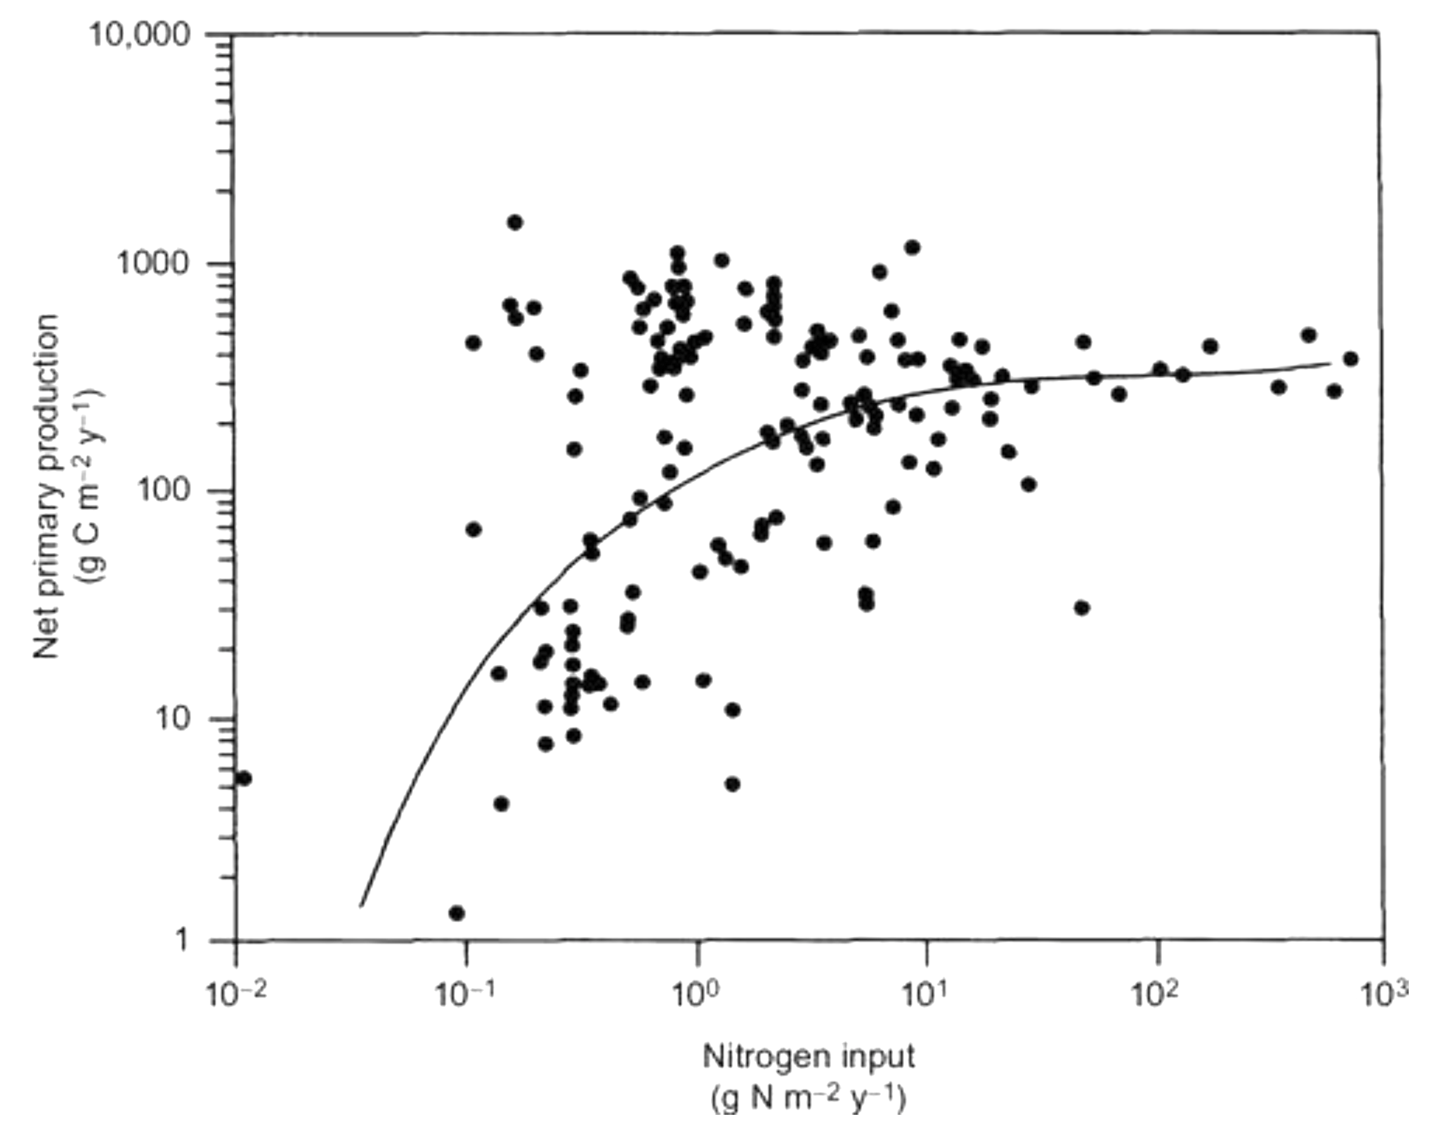
You can too much of a good thing!
Nitrogen saturation is a sustained supply of available N in excess of biotic demand
After 13 years of N additions
Zak et al. 1989 CJFR
Ambient N input
Schlesinger & Bernhardt 2013 from Levin 1989
NPP vs N inputs to terrestrial, marine, & aquatic systems
N saturation may:
deplete soils of exchangeable nutrient cations
increase toxic Al⁺⁺⁺ levels
alter soil- and stream-water chemistry
reduce the growth of trees
reduce species diversity
+50 kg N/ha*yr
+150 kg N/ha*yr
Notes:
Magill et al 2004
Zak et al. 1989 CJFR
Schlesinger & Bernhardt 2013 from Levin 1989
NPP vs N inputs to terrestrial, marine, & aquatic systems

Slide 34
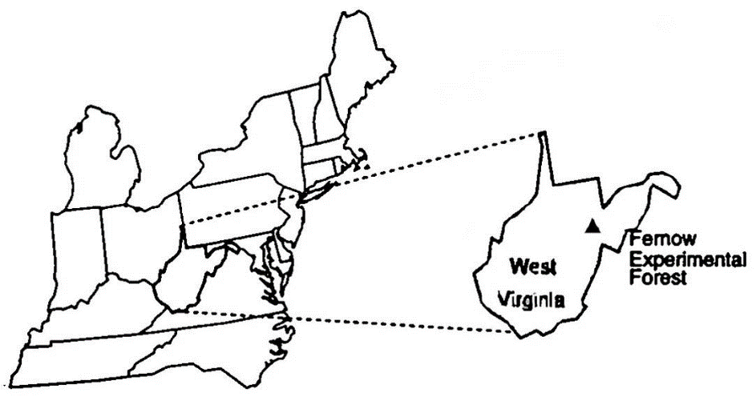
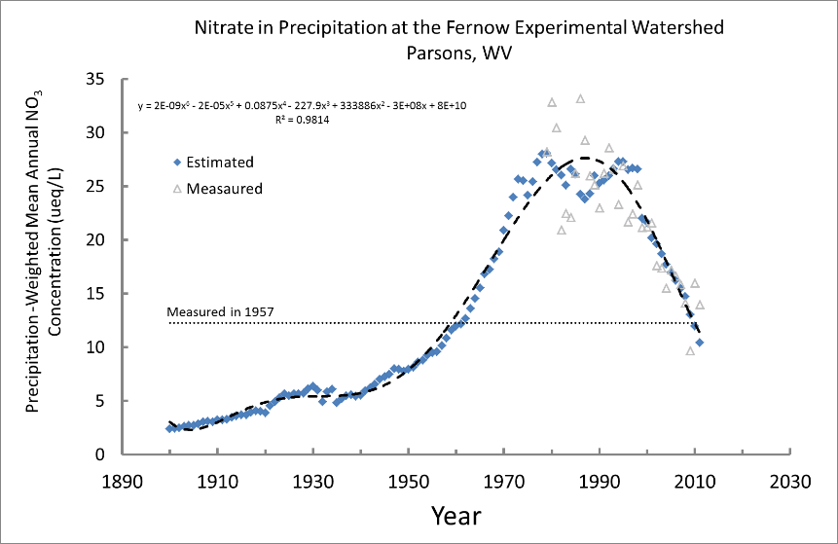
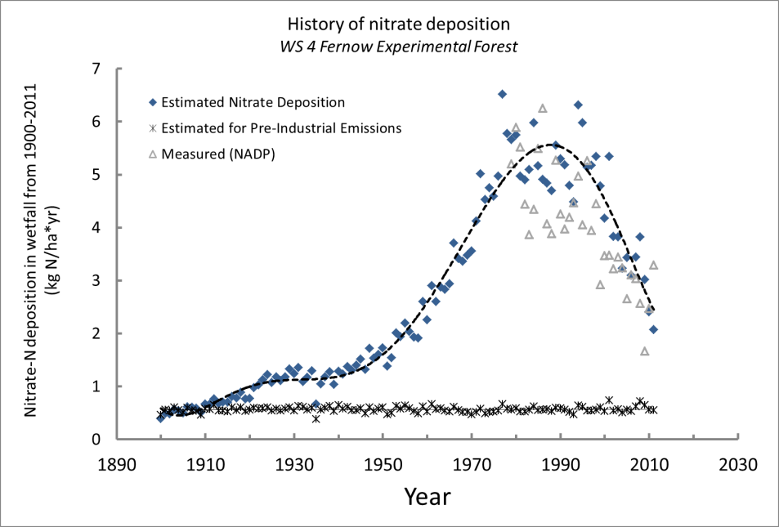
Are these the shadows of the things that Will be,
or are they shadows of things that May be, only?
Charles Dickens
A Christmas Carol

